Slide 1
EEGR 417
Section 2: POST-SYNTHESIS

Slide 2
Section Outline
Review
Fault Basics
Fault Modeling, Detection and Mitigation
Test Vectors
ATPG
Scan Chain Overview & Insertion/ DFT
JTAG

Slide 3
Section Outcome
Introduce concepts and tools necessary for proper validation
Layout process of performing effective post-synthesis validation
Present techniques for generating high coverage test patterns.
Present methods for Testing full Systems on Chips and Boards.

Slide 4
Design and Test
Producing a digital system begins with a designer specifying a high-level design language
Ends with manufacturing and shipping parts to the customer.
This process involves many simulations, synthesis, and test phases.

Slide 5
Register transfer level (RTL) Design Process
Designer writes design specification in an RTL language such as Verilog.
Using standard HDL (Hardware Description Language) descriptions and testbenches in the same HDL
Description will be simulated and tested for design errors.

Slide 6
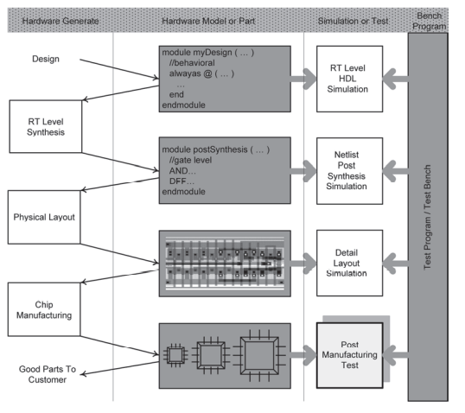
IC Design Process

Slide 7
RTL Simulation
Primarily functional that is extracted from the original specification of the circuit being designed
Detailed timing checks and physical flaws are not addressed at this level of simulation.

Slide 8
RTL Simulation
Can inject design errors to predict the behavior of the design under unanticipated circumstance.
After a satisfactory simulation, and when the designer is reasonably sure the design meets the design specifications, move on to RT level synthesis

Slide 9
RT Level Synthesis
Takes the behavioral description of a design (myDesign) as input, and produces a netlist of the design
Specifies interconnection of low-level basic logic components such as AND and OR gates and D-type flip-flops.

Slide 10
RT Level Synthesis
Netlist must be tested an HDL simulation tool.
referred to as postsynthesis simulation.
Checking for delay issues, races, clock speed, and errors caused by misinterpretation of the RT level design by the synthesis tool

Slide 11
Physical Layout
Verified post-synthesis netlist of the design is used by a layout and placement tool for generating the design’s layout and routing of cells.

Slide 12
Physical Layout
Output of this phase also needs to be tested and verified for correctness.
Simulation here verifies wire lengths, wire widths, and transistor sizes, and detects layout and placement flaws that can be introduced from a netlist to its layout

Slide 13
Chip Manufacturing
Manufactured chips must be individually tested and verified against flaws before they are shipped to the customers

Slide 14
Chip Manufacturing
Testing phase for testing the actual, post-manufacturing, chips is what is referred to as test or testing in digital system design industry.
Testing the circuit under test (CUT) against manufacturing defects
broken wires, shorts, open resistive wires, transistor defects, etc.

Slide 15
Design-Under-Test & Testers
Segment Outcomes
Students will learn the formal definition of DUT.
Students will be introduced to different testers and methods of testing.

Slide 16
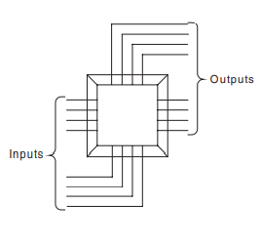
Device Under Test
Can be a system, a board, a packaged chip, a chip, a die on a wafer, a core on a die, or a section of a core
Treat as a Blackbox that can only be controlled and observed from the outside

Slide 17
Device Under Test
Generate test vectors, generate expected outputs vectors, compare output vectors to expected output vectors.

Slide 18
Testers
Device or equipment that applies test vectors to a DUT, collects DUT’s responses, and makes comparisons with the expected data.
Specially made and designed for testing a specific device.
DUT can test itself.
built-in hardware that has been primarily designed for testing the rest of the hardware of the DUT. Built-in Self-test (BIST).

Slide 19
Types of tests
External Testing:
A device is tested by an external device that can be a chip, a board, or a computer or test equipment.
Internal Testing:
The tester for a device is in the same packaging as the device.
Built-in Self-Test (BIST): the tester hardware is integrated with, and on the same chip as the device.

Slide 20
Types of tests
Online Testing.
Testing is done while a device is performing its normal functions.
Offline Testing.
Device being tested must cease its normal operation, and then be tested.
Offline testing can be done by internal or external test hardware

Slide 21
Concurrent Testing
Concurrent Testing (Online).
Normal/Expected used in preforming normal functions are used for testing it.

Slide 22
Concurrent Testing
Concurrent Testing (ATE).
Tester is testing various parts of a chip concurrently.
I.E the analog, memory, and the logic parts tested at the same time.

Slide 23
Testing Speed
At-Speed Testing.
Device being tested at its normal speed of operation, also called AC Testing
DC Testing.
Device is tested at much slower speed than its operation frequency. Allows all events to propagate before outputs are sampled

Slide 24
Types of Tests
In-Circuit Testing.
Device being tested is not removed from its mounting place for testing.

Slide 25
Types of Tests
Guided Probe Testing.
In a process of probing backwards from outputs towards inputs.
Testing is done to find the source of an error that has appeared on the circuit’s outputs.

Slide 26
Types of Tests
Diagnostic.
When testing is done to find the cause of failure

Slide 27
Work smart, not hard?
Combinational circuit with 64 inputs, 64 outputs, and 12 ns internal delay.
Tester running at 1 GHz clock frequency, and it takes four clock cycles (4 ns) to fetch a new test vector and apply it to the circuit.

Slide 28
Work smart, not hard?
At this tester frequency, it takes four clock cycles to lookup the output and compare it with the expected result
How long to test?
Test time : 2^(64) * (12 + 4 + 4)* 10^(-9)s ~ 11,698 years
Why not work smart and hard!

Slide 29
Test Methods
Use algorithms and methods to reduce number of test vectors, select vectors more wisely than just trying every combination
Simplify faults that can occur.
Use a reduced number of faults.
Find mechanisms for evaluating test vectors.
Find parts of circuit that are harder to test.
Generate tests that target hard to test areas.
Evaluate test vectors and keep more efficient ones.
Compact test vectors.

Slide 30
FAULTS
Segment Outcomes
Students will be introduced to fault types and causes
Students will be introduced fault logic reduction and logic minimization.

Slide 31
Faults
Fault
A representation of a defect
Used in computer programs for analyzing defects in electronic components
Defect
A flaw in the actual hardware

Slide 32
Fault
Error
Caused by a defect
Happens when a defect in hardware causes a line or a gate output to have a wrong value.
Failure
occurs when a defect causes a misbehavior in the functionality of a system that cannot be reversed or recovered.

Slide 33
Fault Abstraction
Effects of defects in a circuit may be seen at different levels of abstraction
i.e., Physical defect of a short between an nMOS transistor gate and its source may be seen at the switch, gate, RT, or system-level

Slide 34
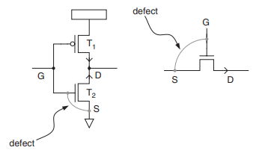
Gate Fault
Mask misalignment in layout may cause a short between gate of a transistor and its source
defect translates to T2 switch transistor always staying open.

Slide 35
Gate Fault
Same defect translates to switch level fault of switch output being open when it is supposed to be 0.

Slide 36
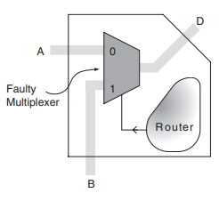
Functional Faults
Fault that affects functionality of a system
Example:
Faulty inverter in a multiplexer circuit causes the overall functionality of the multiplexer to be faulty

Slide 37
Functional Faults
Functional fault of a component at a certain level of abstraction ignores lower-level details of the component
Only considers the input–output behavior of the component

Slide 38
Structural Faults
Complexity of analysis for extracting a faulty model for a component can be simplified by analyzing its sub-components.
(e.g., inverter, AND, and OR gates) and their interconnections (e.g., line i in Fig. 3.5)

Slide 39
Structural Faults
Consider only interconnection faults
lump faults on the two ends of an interconnection and of interconnect itself into faults belonging only to the interconnection.

Slide 40
Structural Faults
Assume that components forming a hardware module are fault free.
Assume only the interconnection of the components may be faulty

Slide 41
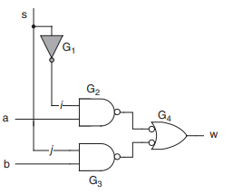
Structural Fault
I.E Inverter fault becomes fault on line i

Slide 42
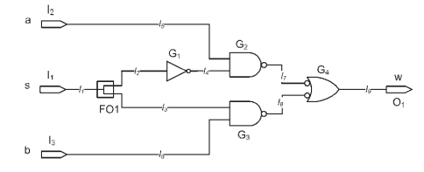
Recognizing Faults
Label possible points of failure
Write w as a function of a,b,s
W_good = (a and (not s)) or (b and s)

Slide 43
Recognizing Faults
Now assume a failure at I4, stuck at 1
W_fault = a or (b and s)
Since W_good != W_fault
I4 can be recognized

Slide 44
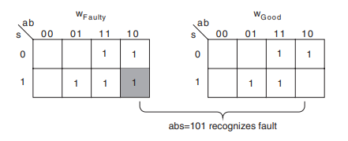
Boolean Difference : Karnaugh maps
Create two k-maps
One the good function
the other the faulty function
Input combination where the k-map entries are different represent valid test vectors.
i.e recognize the faulty circuit from the good one

Slide 45
Example
stuck-open fault on L3
l3 and l2 are branches of a fanout whose stem is l1
l3 stuck open causes the G3 gate to retain its charge forever
G3 acts like an inverter

Slide 46
Stuck-at-x faults
Stuck-open
Stuck-at-0
models' defects on a line or its interconnecting gates such that the line value appears as though it is always 0
Stuck-at-1
models' defects on a line or its interconnecting gates such that the line value appears as though it is always 1

Slide 47
Bridging Faults
Defects on neighboring gates and lines may cause a bridging effect on two lines.
AND bridging
two bridged lines appear as if they are forming an AND functions which feeds all destinations of the bridged lines
OR bridging
Depending on the logic behind and after a bridging fault, the fault may be modeled by an OR function instead of an AND function.

Slide 48
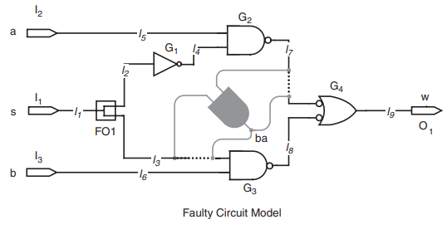
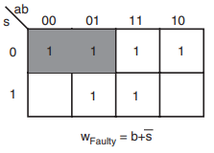
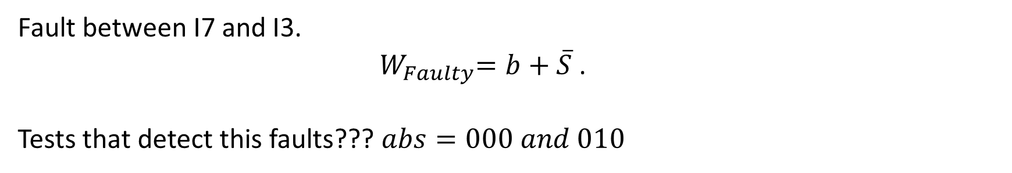
AND-bridging Faults
Fault between I7 and I3.
${ W}_{Faulty}=b+\overline{S}$ .
Tests that detect this faults??? $abs=000 and 010$

Slide 49
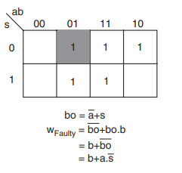
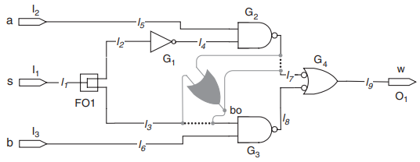
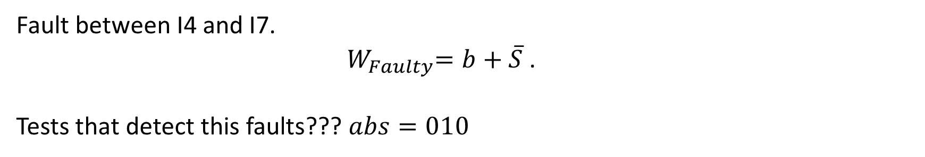
OR-bridging Faults
Fault between I4 and I7.
${ W}_{Faulty}=b+\overline{S}$ .
Tests that detect this faults??? $abs=010$

Slide 50
Fault Modeling
Segment Outcomes
Students will o understand fault simulation and use this process for improving test and testability of their designs during the design phase.
Students will learn to use fault simulation for test data generation, test set evaluation, circuit testability evaluation, providing information for testers, finding faults in a circuit, diagnostics, and many other applications.

Slide 51
Fault Model
Representation of a defect and is used in computer programs for analyzing defects in electronic components.
The good circuit model (Golden Model), and the Faultable Model are instantiated and a setup for comparing and reporting their responses is proved

Slide 52
Multiple Faults
Any number of faults can happen in a circuit simultaneous in any combination.
Permutations quickly become intractable.

Slide 53
Multiple Faults
Multiple faults may distort the faulty effects of each other and prevent all such faults from being detected.
multiple faults can mask each other, and presence of a certain fault may never be known.

Slide 54
Fault Simulation Assumptions
Circuit netlist with provisions to become faulty
Good circuit netlist or behavioral description
A file containing test data
A file containing fault list

Slide 55
Fault Simulator Outputs
Report files
Flags and messages

Slide 56
Sequential Circuit Fault Simulation
Different from combinational fault simulation.
Internal states of the circuit and its clocking and resetting requirements.

Slide 57
Sequential Circuit Fault Simulation
Reset is required with every fault that is injected in the circuit.
Internal flip-flops of the circuit may be holding values from the last fault and last set of inputs.

Slide 58
Sequential Circuit Fault Simulation
Clocking the circuit after the application of a test vector.
Allows faults hidden in the internal states of the circuit to appear on the circuit primary outputs.
Example: fault the effect of which reaches circuit flip-flop input, but not any of the circuit’s primary outputs.
Upon clock input:
this fault gets another chance to come back into the logic of the circuit.
possibly appears on the circuit primary outputs.

Slide 59
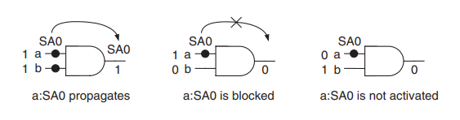
Fault Activation
Fault is activated if the line value reaching the fault is different from its faulty value.

Slide 60
Fault Activation
A “0” on a line with SA1 fault activates it

Slide 61
Fault Activation
A “1” on both inputs activates a SA0 fault.

Slide 62
Fault Coverage
Fault coverage (or test coverage) is the ratio of detected faults over total faults in a circuit.
Fault simulation is used as a stand-alone program to calculate fault coverage to measure how good the test set is.

Slide 63
Fault Coverage Procedure
Start with a given test set and a fault list
Assume a good circuit model and a faultable model are instantiated and being compared
Procedure consists of two nested loops

Slide 64
Fault Coverage Procedure
procedure consists of two nested loops
outer loop considers every fault in the fault list
inner loop applies tests in the test set to the faulty circuit until one detects the fault

Slide 65
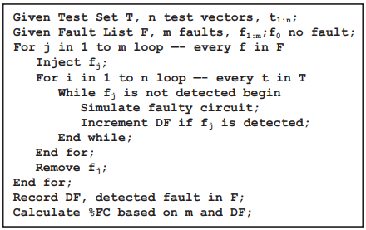
Fault Coverage Procedure

Slide 66
Sequential Circuit Fault Coverage
Different from combination fault coverage.
Application of reset after injection of each fault
application of clock after assigning a test vector to the circuit inputs.

Slide 67
Test Refinement
Test efficiency is the number of faults covered by a test vector.

Slide 68
Test Refinement
Fault simulation can be used to:
identify test vectors that are low in efficiency
Identify test vectors that detect faults already covered by other test vectors.

Slide 69
Test Refinement
Based on efficiency and coverage:
If it is found that there are tests that do not have a significant contribution to the overall fault coverage.
Have no contribution at all, they can be removed from the test set.

Slide 70
Test Refinement
Test set can be refined for the fewest number of tests and the highest coverage.

Slide 71
Random Test Generation
Random test generation can be regarded as a complement or a replacement for costly automatic test pattern generation algorithms.
Randomly generated input vector is examined for detection of faults
Keep or discard test vector based on whether fault is detected.

Slide 72
Fault simulation for random tests
Test t is randomly selected and its efficiency in detecting undetected faults is measured by a fault simulation loop.

Slide 73
Fault simulation for random tests
Remaining undetected faults are injected into the circuit-under-test, and a counter is incremented if the random test vector, t, detects the injected fault f.

Slide 74
Fault simulation for random tests
At the end, the value of this counter is used in deciding on keeping or discarding the test

Slide 75
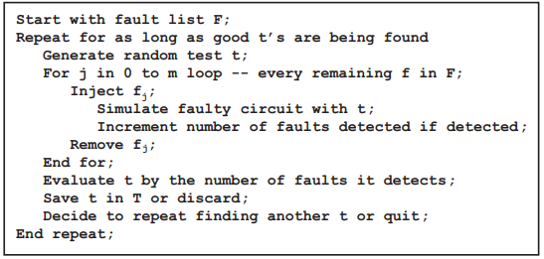
Fault simulation for random tests

Slide 76
Fault-oriented Test Generation
Fault-oriented test generation is a process that a certain circuit fault is selected, and a test is generated for it.
test generation scheme is a complex process and requires many iterations though the circuit for producing a test vector that detects the targeted fault.

Slide 77
Fault-oriented Test Generation
Once the test is found, identify other faults that are detected by the same test vector.
eliminates the need for repeating the test generation process for faults that are already detected.

Slide 78
Fault-oriented Test Generation
Identifying faults detected by a test vector, in addition to the fault that was targeted, is done by fault simulation.
fault-oriented test generation program usually includes fault simulation, as part of its process.

Slide 79
Fault-oriented Test Generation
When test t is generated, it is applied to the circuit input.
Faults that are not detected are injected in the circuit one at a time.

Slide 80
Fault-oriented Test Generation
Faults in a faulty circuit that produce a different output than the good circuit output are marked as detected.
Such faults are removed from the list of faults for which test needs to be made.

Slide 81
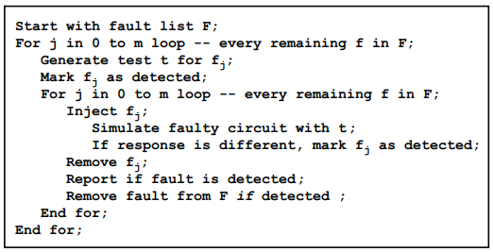
Fault-oriented Test Generation

Slide 82
Fault Dictionary
Fault dictionaries are data bases in which a correspondence is made between circuit faults and test vectors that detect them.
used in hardware testing for fault diagnosis.

Slide 83
Fault Dictionary
In its simplest form:
a fault dictionary for a combinational circuit is a two-dimensional table
its rows designating circuit faults and its columns representing test vectors.
READ CHAPTER 4.2.3.1

Slide 84
Fault Simulation Techniques
Segment Outcomes
Students will learn several fault simulation techniques for performance improvements.
Students will learn techniques to obtain better performances by parallel propagation of test vectors, propagating faults instead of tests, simulating only parts of the circuit, taking advantage of behavioral codes, and other optimization techniques.

Slide 85
Serial Fault Simulation
Simplest fault simulation method
Faulty model simulated for all test vectors and results are compared for the detection of the injected fault.

Slide 86
Serial Fault Simulation
In serial fault simulation
a fault is injected
test vectors are applied
when the fault is detected, or tests are exhausted
a new fault is injected.

Slide 87
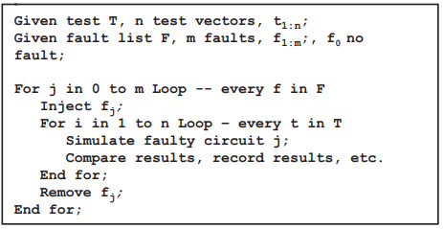
Serial Fault Simulation
With this new fault, the circuit is reset, and the new faulty circuit is simulated, and the same procedure is repeated.

Slide 88
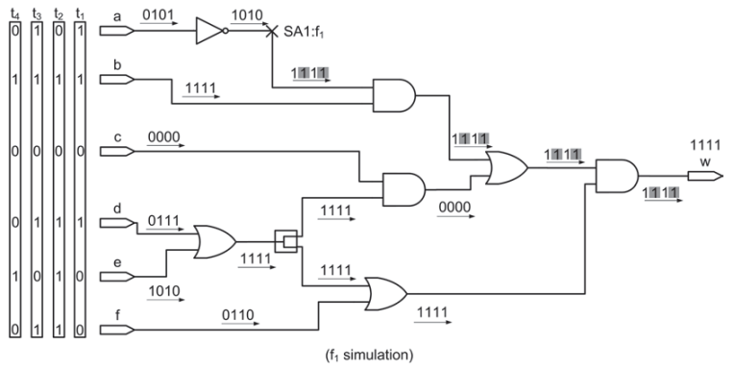
Serial simulation

